Slide 1


Crafting PDF Readers with floating points
@pastacls

Slide 2

Who am I?
1
intro
Member of Infobyte’s faraday-labs.
Security Researcher
bug hunting
vuln research
Local Ping Pong Champion
Notes:
agregar Foto, agregar algun hobby o desafio (campeon invicto de ping pong)

Slide 3
Previous work
2
intro
Sebastian apelt at infiltrate 2016
The shadow over firefox on phrack 69

Slide 4
Agenda
3
intro
Out of Bounds bugs
Javascript Internals at Adobe Reader
IEEE 754 or floating point format
exploiting for fun and profit

Slide 5
Out of Bound bugs
4
intro
Out of Bound read
Out of Bound write
OOB bug fixes in Adobe Reader

Slide 6
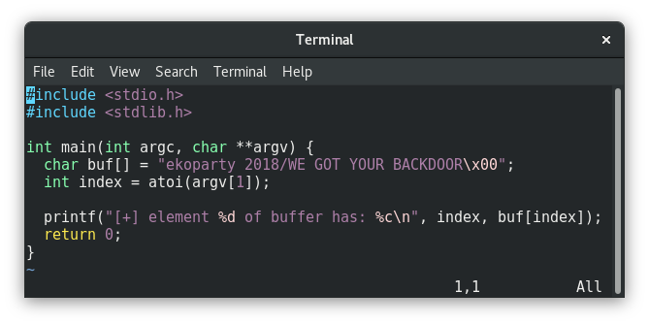
5
Out of bound read
example program

Slide 7

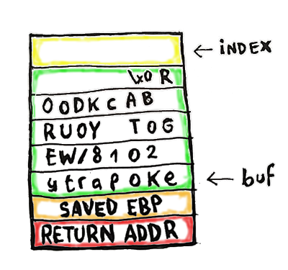
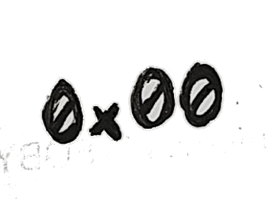
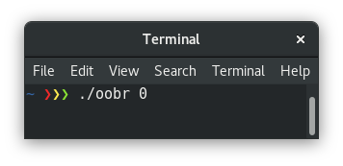
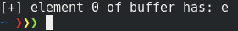
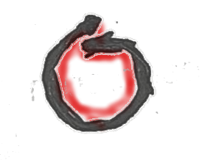
6
Out of bound read

Slide 8
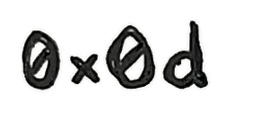

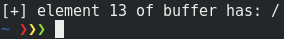
7
Out of bound read

Slide 9
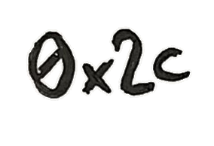
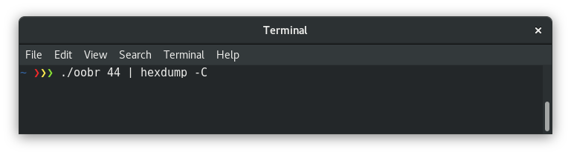
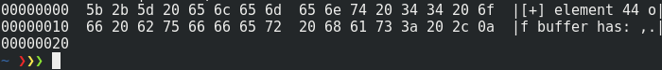
8
Out of bound read

Slide 10
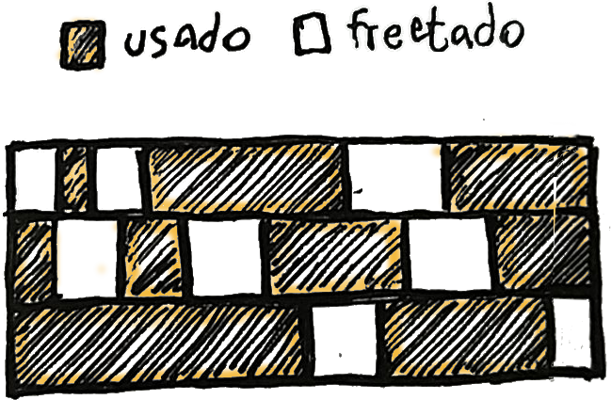
9
Out of bound read
memory layout

Slide 11
Out of Bound read
10
intro
Useful for leaking memory
bypass ASLR leaking a module address.
canaries or stack guards.
sensitive information.
avoid landing in unmapped memory.

Slide 12
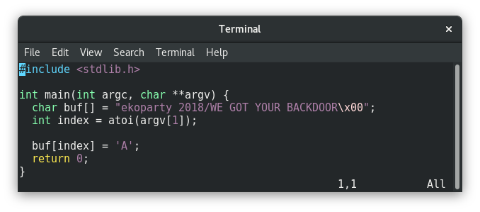
11
Out of bound write
sample program

Slide 13
Out of Bound write
12
intro
We arbitrary rewrite a byte in memory.
Not only applicable to char arrays
the controlled index can be from ptr to an int, floats, structs or any type of data structure.
we only need a ptr with a craftable index.

Slide 14
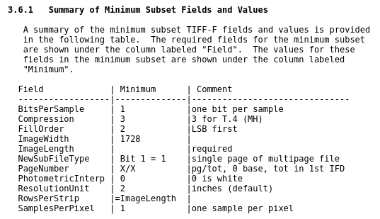
Cuando se nos escapa la tortuga
13
in adobe
File formats with an array-index type file structures:

Slide 15
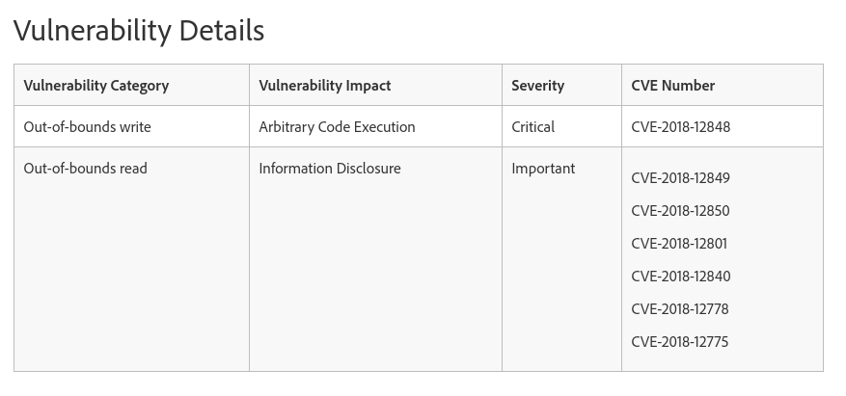
Adobe’s Security Bulletin
14
in adobe
Bugs fixed on 19/09/2018

Slide 16
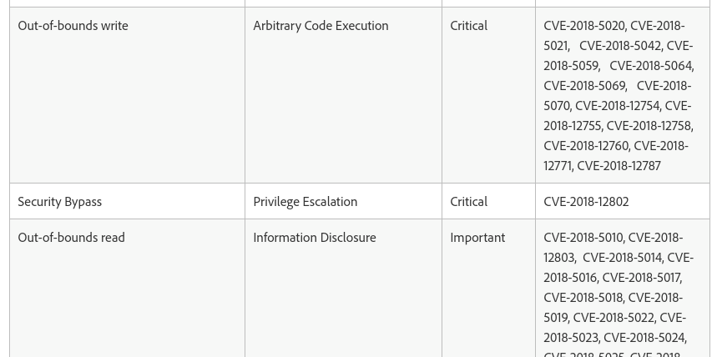
Adobe’s Security Bulletin
15
in adobe
Bugs fixed on 10/06/2018

Slide 17

What can we rewrite?
16
in adobe
we can’t predict memory addresses.
we don’t know the base address of the wrongly index buffer.
we don’t know the destination address.

Slide 18
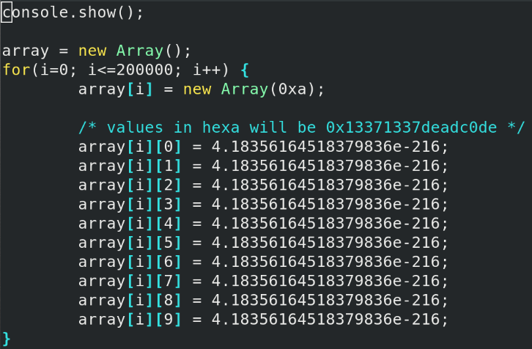
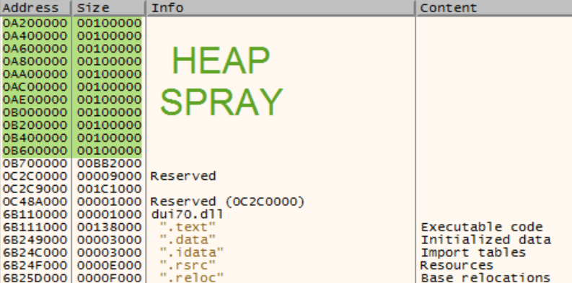
Positioning objects in memory
17
Heap spray with javascript.
in adobe

Slide 19
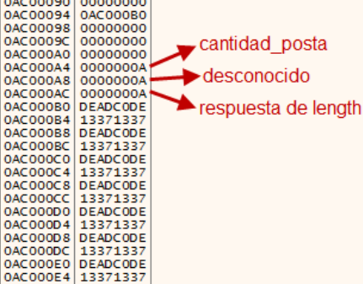
The floats array in memory
18
Adobe uses the js spidermonkey engine
javascript
internals

Slide 20
NaN format
19
javascript
internals
Any element of the 2 DWORDS array.
If it isn’t a floating number, then it is an integer, null, undefined, boolean, object or string.
The first DWORD is the value or a data pointer, and the second one a tag that defines the type

Slide 21
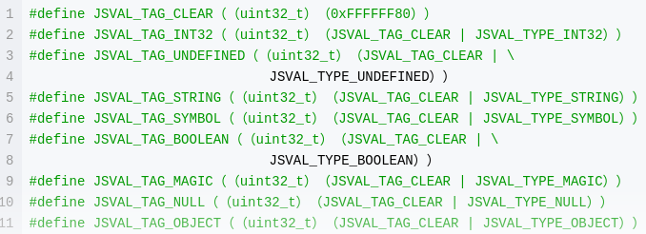
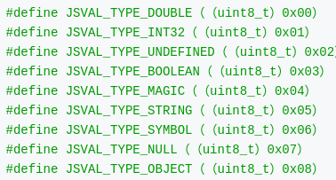
Formato NaN
20
javascript
internals
Types of data tags:

Slide 22
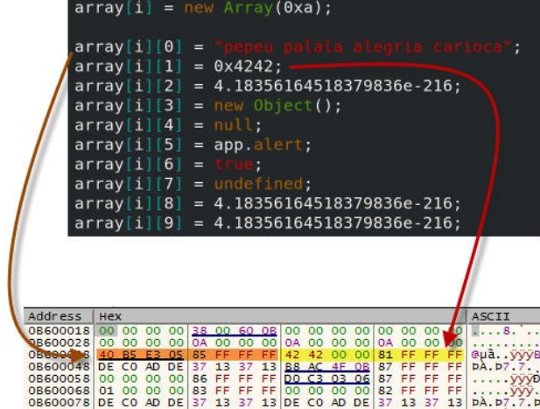
NaN format
21
javascript
internals

Slide 23
Stepping on Arrays headers
22
release the kraken
We will trigger the Out of Bound write bug to crush a header of the heap spraying arrays
Cool read and write primitives by using js
They don’t support any value

Slide 24
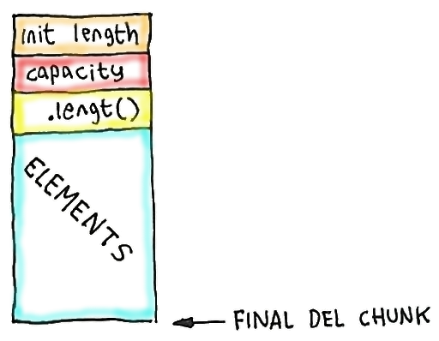
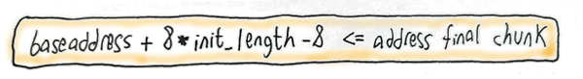
Stepping on Arrays headers
23
Limitations:
release the kraken
thread worker going through each element (possible garbage collector)

Slide 25
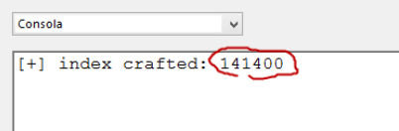
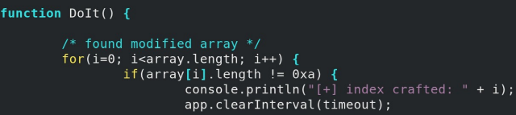
Stepping on Arrays headers
24
release the kraken
Finding the stepped header

Slide 26
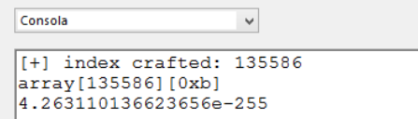
Reading primitive
25
RELEASE THE KRAKEN
Reading beyond the original boundaries

Slide 27
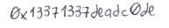
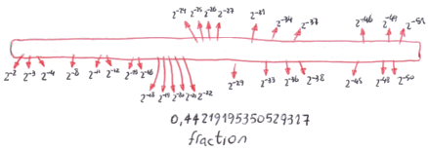

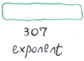
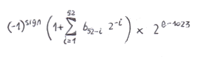
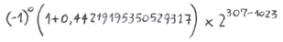
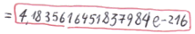
26
floating point format
from hexa to a floating point

Slide 28

27
floating point format
from hexa to a floating point

Slide 29
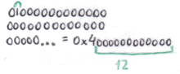
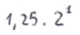
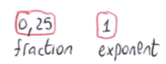
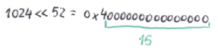
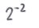
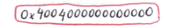
28
floating point format
From a floating point to hexa with float bigger than one

Slide 30
Things to consider
29
floating point
If the float is between 0 and 1, it multiplies by two instead of dividing it.
If the fraction can’t be represented as the sum of negative powers of two, it will approach until the distance is lower than 2⁵³

Slide 31
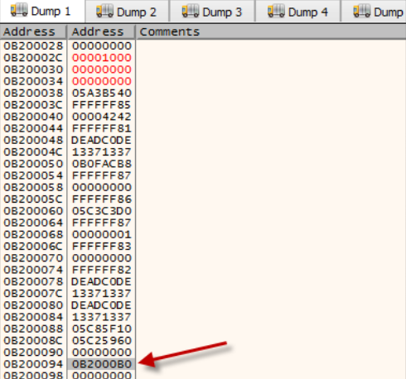
Python algorithm
30
floating points
Understanding the leaked number:

Slide 32
¿What do we have so far?
31
release the kraken
From the crafted array we can access the subsequent arrays.
We can’t create objects.
We only query our data.
We have an almost self-referential pointer because of the agglutinated spray.

Slide 33
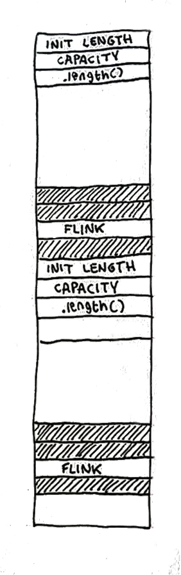

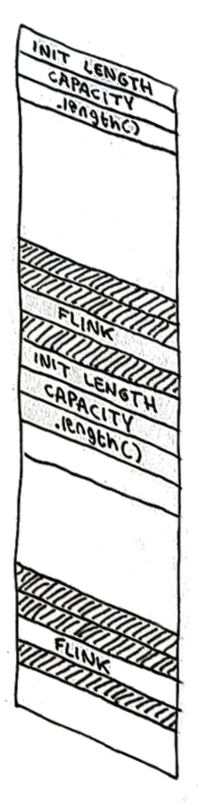

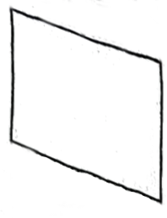



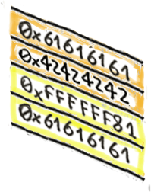

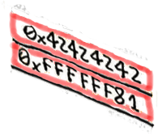
32
object builder

Slide 34
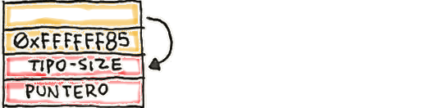
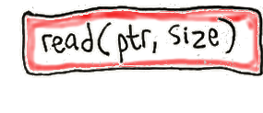
Reading primitive
33
release the kraken
With the object builder we create an arbitrary string element

Slide 35
Reading primitive
34
release the kraken
Full access of the memory space.
If we pass it through unescape it comes out as hexa.
Easy way of prototyping readDWORD and readBYTE helper functions

Slide 36
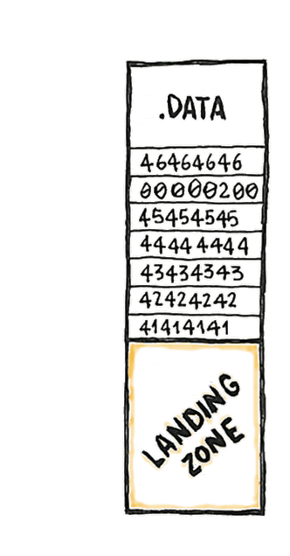
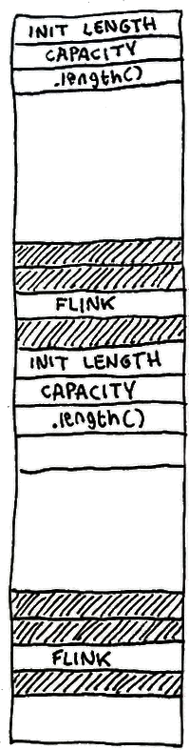


35
pseudo writing primitive

Slide 37
Pseudo writing primitive
36
release the kraken
as long as we find a header "k" it will let me rewrite it with fake arrays
the landing must be writable, not the header
I did not have to fix the linked list

Slide 38
Taking control of the execution flow
37
release the kraken
We can create a reference to a function of js like app.alert and that leaves a pointer in the object
We duplicate that object with the object builder but with the modified function pointer
one-shoot is not allowed, “it doesn’t work with DEP”

Slide 39
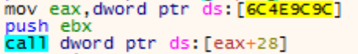
Using the trampoline
38
release the kraken
We create a reference to app.alert and a fake object duplicating that object but with the redirected ptr function
To deactivate DEP we write the ROP by overwriting a call table in .data of the module EScript.api

Slide 40

Landing the ropchain
39
release the kraken
We make the floating fake array by positioning the ropchain:

Slide 41

Taking control of the execution flow
40
release the kraken
We divert the flow to the indirect call and lift as a first gadget a stack pivot that leaves us positioned the ropchain in the stack

Slide 42

41
demo time

Slide 43
Tips to consider
42
final
There is a similar technique with ArrayBuffers
The primitives are simpler, reading writing throughout the memory space
Not so automatic the taken execution
I saw it after I did this, when an exploit appeared without payload, 4 months ago.

Slide 44
Thank you,
Questions?
Javier “pasta” Aguinaga jaguinaga@faradaysec.com twitter @pastacls
www.faradaysec.com

